Slide 1
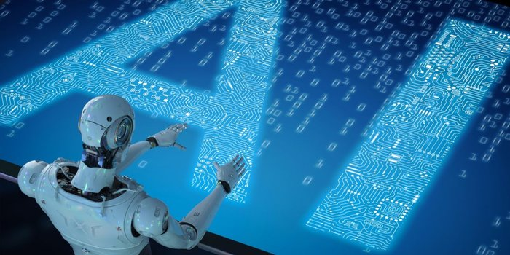
Artificial Intelligence An Ocean of Opportunity

Slide 2
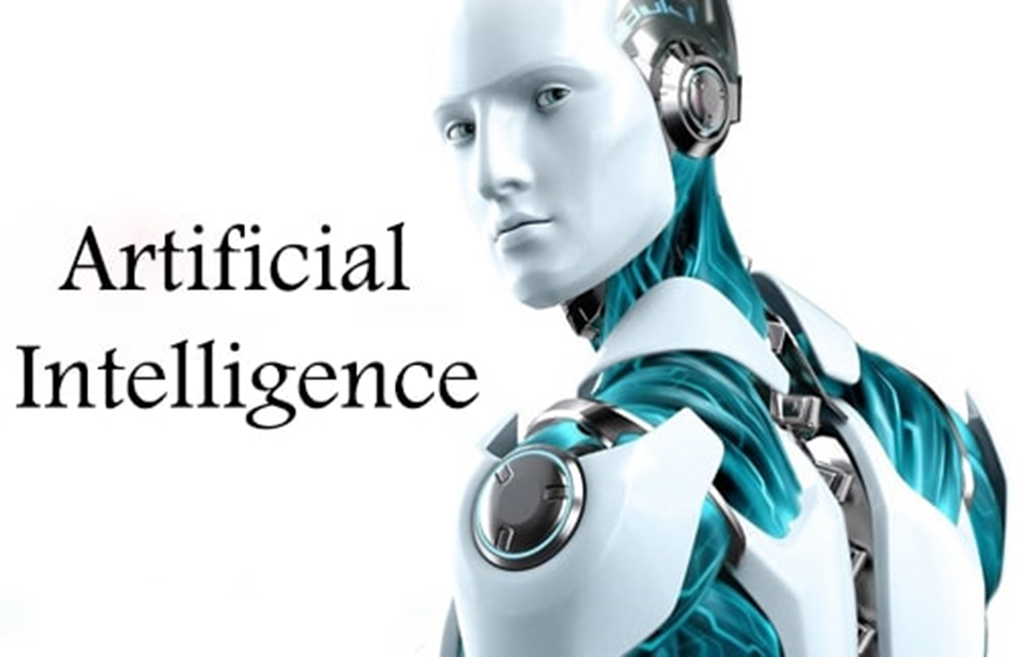


Course Outline
Artificial Intelligence
Deep Learning
Probability & Statistics
Machine Learning
Python Programming

Slide 3


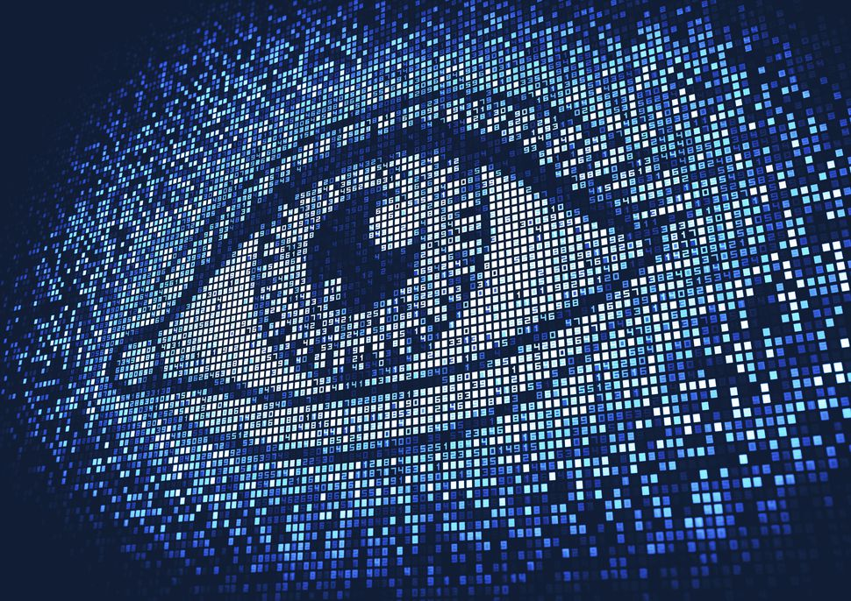

Artificial Intelligence

Slide 4

Why Artificial Intelligence?
Let’s begin by understanding various applications of Artificial Intelligence in real life

Slide 5










Why Artificial Intelligence?
Input
Predict whether a patient has diabetes based on the characteristics of his body
We have a million patient records to learn from
Do you want a human to learn from this data or task a machine to do so ?
Human
Machine

Slide 6







Why Artificial Intelligence?
Disadvantages
Advantages
Human computational power is limited
Have high computational power
Humans have limited working capacity
Can work 24/7 with same efficiency

Slide 7
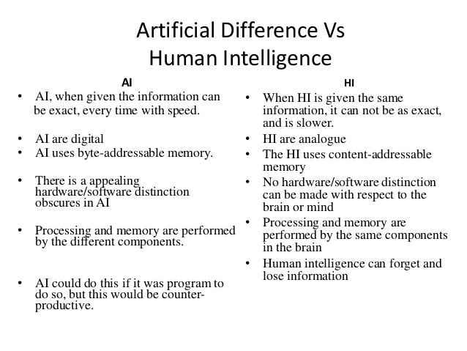
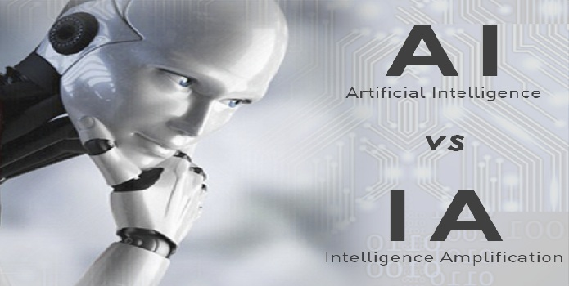
Artificial Intelligence Vs Human Intelligence

Slide 8
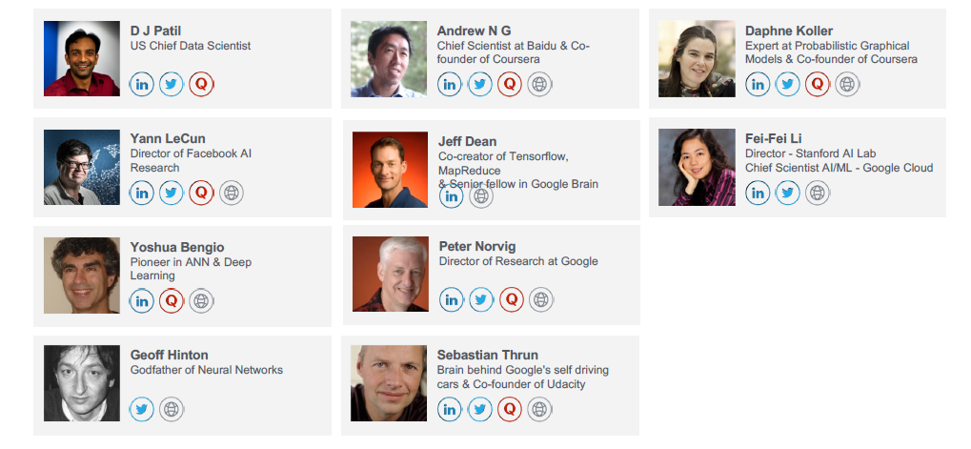
Real Artificial Intelligence Expert

Slide 9
What is Artificial Intelligence?
We’ll also discuss subset of AI and it’s major domains

Slide 10

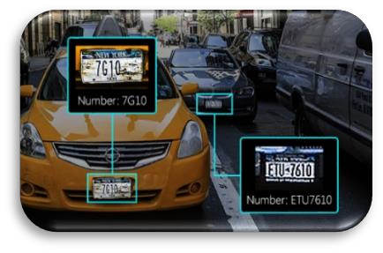
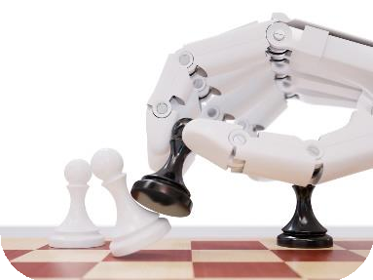

What is Artificial Intelligence?
The theory and development of computer systems able to perform tasks normally requiring human intelligence, such as visual perception, speech recognition, decision-making and translation between languages. – source – Wikipedia
AI is a branch of Computer Science and mimic the human behaviour.
Number plate recognition
AI includes following areas of Specialization:
Game Playing
Expert systems
Natural Language processing
Neural networks
Robotics
Machine playing chess
Siri

Slide 11
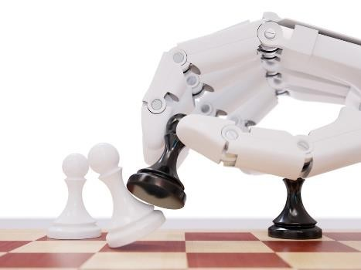
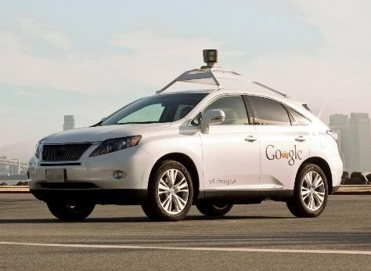

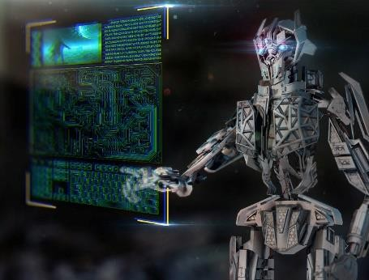
Artificial Intelligence - Domains
Machine playing chess
Google’s Self driving car
Game Playing Programming computers to play games against human opponents
Expert Systems
Programming computers to make decisions in real-life situations
Add Text Here
Add Text Here
Natural Language
Processing
Programming computer systems to understand natural human languages
Robotics
Programming computers to see and hear and react according to sensors incorporated in them
Handwriting recognition
Artificial intelligence program - Siri

Slide 12








Artificial Intelligence - Subsets
Machine Learning is a subset
of AI
Machine Learning
Deep Learning uses neural networks to simulate human like decision making
Deep Learning
Deep Learning is a subset of
Machine Learning

Slide 13
Machine Learning
Now let’s understand what Machine Learning is all about

Slide 14

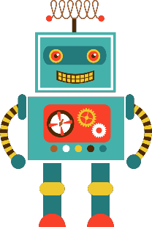
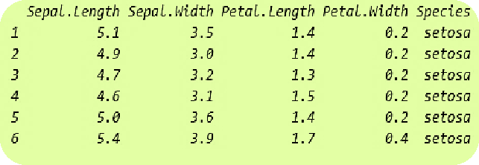

Machine Learning
Machine Learning is a type of artificial intelligence (AI) that provide computers with the ability to learn
without being explicitly programmed.
Problem Statement: Determine the species of the flower
Learn from the dataset

Slide 15

Machine Learning
Machine Learning is a type of artificial intelligence (AI) that provide computers with the ability to learn
without being explicitly programmed.
Problem Statement: Determine the species of the flower
New Input
Sepal length, Sepal width, Petal Length, Petal Width
Learn from the dataset

Slide 16
Machine Learning Types
Supervised | Unsupervised | Reinforcement

Slide 17


Slide 18
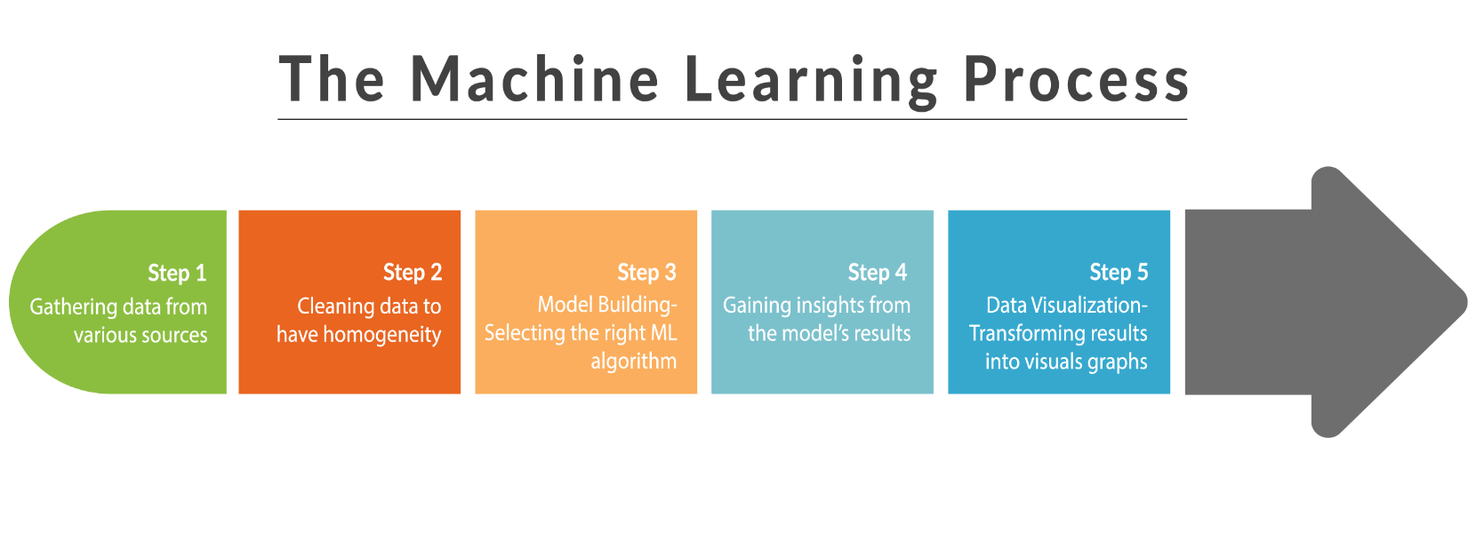
Machine Learning Process

Slide 19
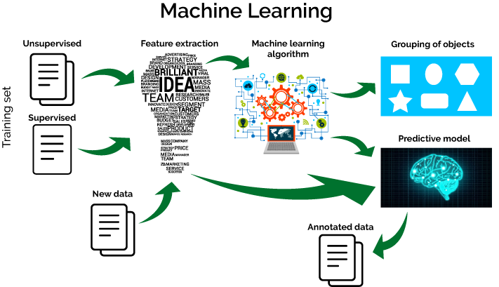
Machine Learning Algorithm

Slide 20
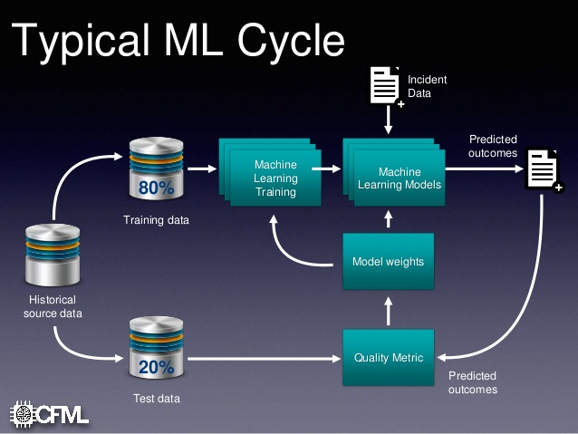
Typical Machine Learning Cycle

Slide 21
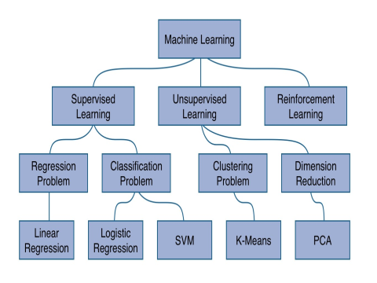
Machine Learning Model

Slide 22
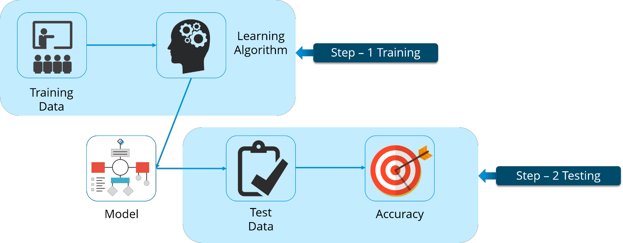


Supervised Learning
Supervised Learning is where you have input variables (X) and an output variable (Y) and you use an algorithm to learn the mapping function from the input to the output.
1
Supervised
Learning
2
Unsupervised Learning
3
Reinforcement
Learning

Slide 23
Supervised Learning Algorithms
Linear Regression
Predicting numerical values such as house price
Regression
Supervised Learning
Logistic
Regression
Predicting binary variables
(yes or no)
Classification

Slide 24
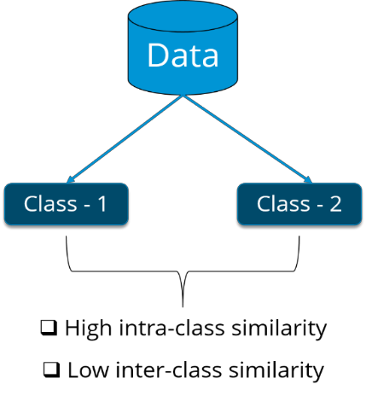
Unsupervised
Learning
Unsupervised Learning is the training of a model using information that is neither
classified nor labelled.
Supervised
Learning
This model can be used to cluster the input data in classes on the basis of their
statistical properties.
1
2
Unsupervised Learning
3
Reinforcement
Learning
Cluster - 1
Cluster - 2
Example: For a basket full of vegetables, we can cluster different vegetables based
upon their colour or size.

Slide 25


Reinforcement Learning
Reinforcement Learning (RL) is learning by interacting with a space or an environment.
Supervised
Learning
It selects its actions on basis of its past experiences (exploitation) and also by new choices (exploration).
Reward
or
11
2
Unsupervised Learning
Reinforcement
Learning
Good Job!
Penalty
3
Bad Job!
Stay on the same lane
Stay on the same lane
An RL agent learns from the consequences of its actions, rather than from being
taught explicitly.

Slide 26
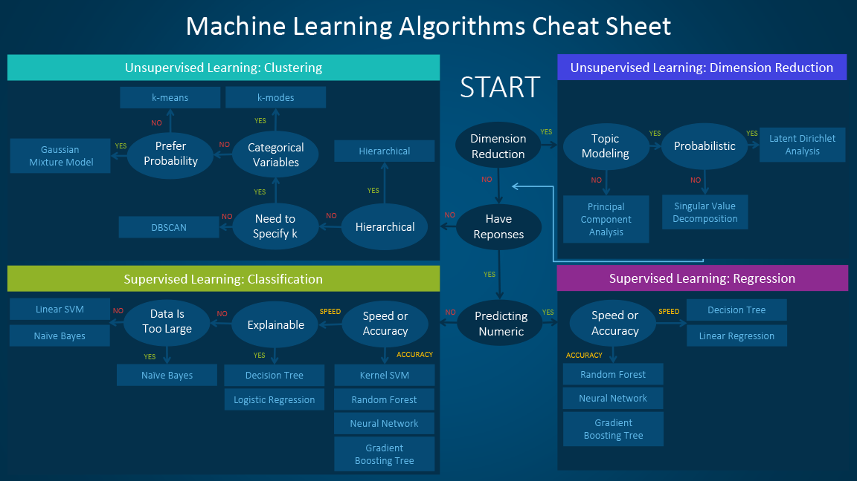
Machine Learning Algorithms Cheat Sheet

Slide 27

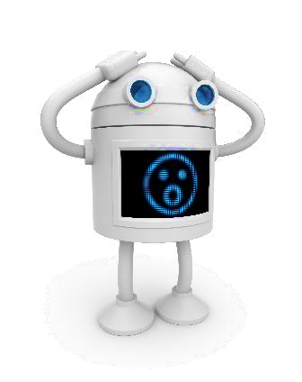
Limitations of Machine Learning
Traditional Machine Learning algorithms have failed to solve crucial problems of AI, such as Natural language processing, image recognition and so on.
Can’t recognize
anything

Slide 28
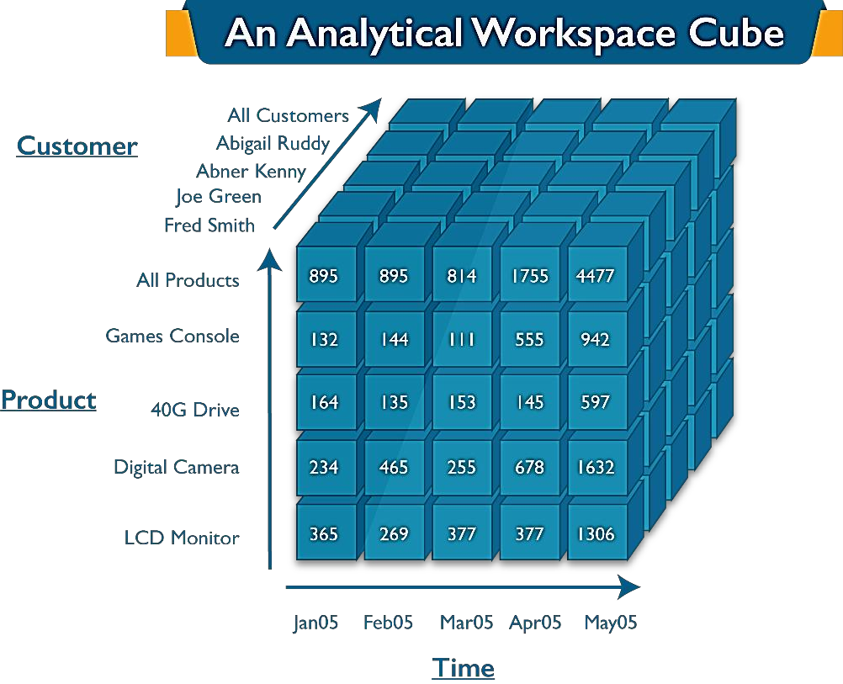
Limitations of Machine Learning
Traditional ML algorithms were not useful while working with high dimensional data, that is where we have large number of inputs and outputs (eg: 100 or 1000 or even more).
People call this “The curse of dimensionality” as they observe certain Machine Learning algorithms may behave poorly when dimensions in the dataset is high.

Slide 29
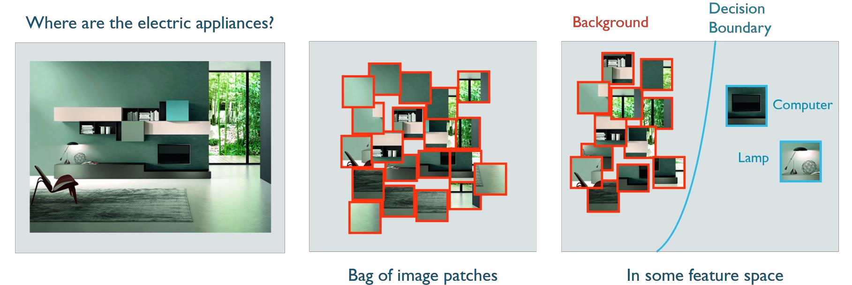
Deep Learning Comes to the Rescue
Deep Learning is one of the only methods by which we can circumvent the challenges of feature extraction.
This is because Deep Learning models are capable of learning to focus on the right features by themselves,
requiring little guidance from the programmer.

Slide 30
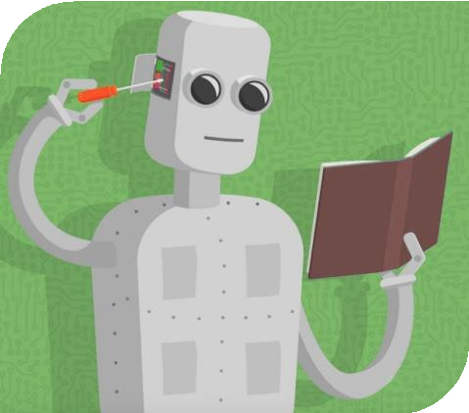
Deep Learning Comes to the Rescue
When dealing with high dimension data, Deep Learning comes to the rescue by partially solving the dimensionality problem.
Deep Learning let users tweak the model complexity by redefining the network structure before feeding the sample for training.

Slide 31
Deep Learning
Now let’s understand what Deep Learning is all about

Slide 32
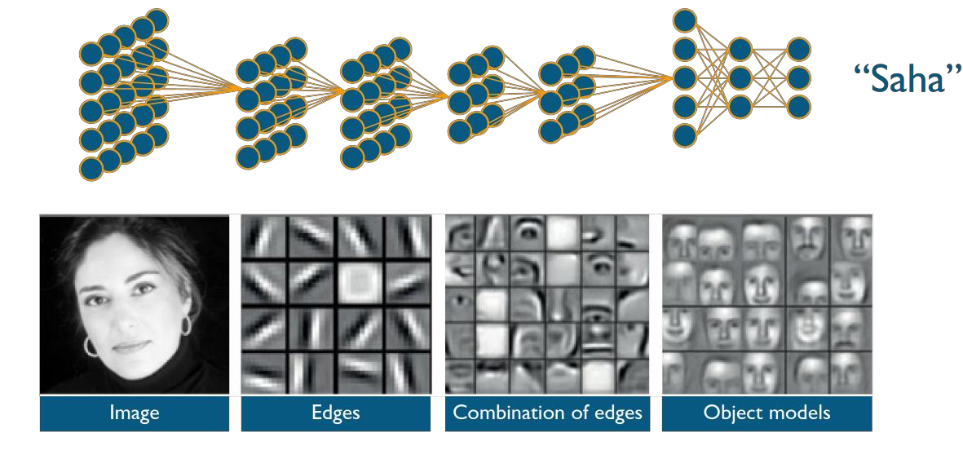
What is Deep Learning?
As recently updated by Wikipedia, Deep learning is a branch of Machine Learning based on a set of algorithms that attempt to model high-level abstractions in the data by using a deep graph with multiple processing layers. It is composed of multiple linear and non-linear transformations.

Slide 33
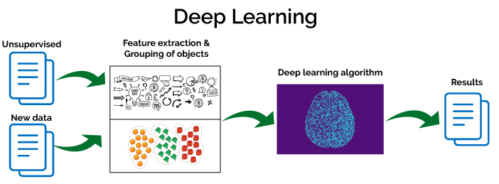
Deep Learning Algorithm

Slide 34
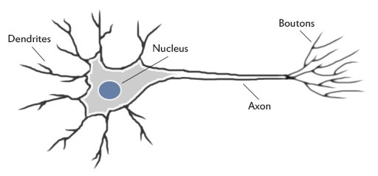
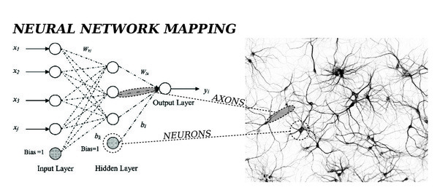
Neural Networks

Slide 35
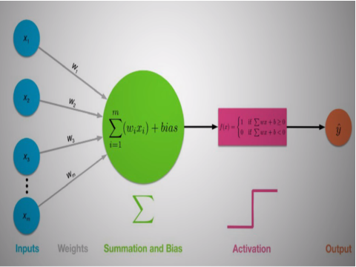
Neural Networks Mapping

Slide 36

Simple Vs Deep Learning Neural Network

Slide 37
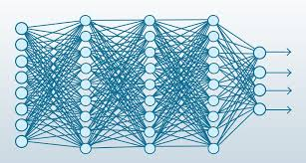
Deep Learning Conventional Neural Networks

Slide 38
Applications of Deep Learning
Now let’s understand what Deep Learning is all about

Slide 39
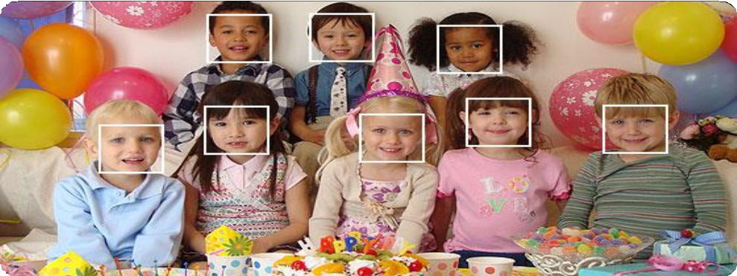
Applications of Deep Learning
Some amazing and recent applications of Deep Learning are:
Automatic Machine Translation
Object Classification in Photographs
Automatic Handwriting Generation
Character Text Generation
Image Caption Generation
John
Andrew
Emma
Colorization of Black and White Images
Automatic Game Playing
Sara
Jessi
Amy
Priya
Adam
Face recognition

Slide 40



Applications of Deep Learning - Google Lens
Google Lens is a set of vision-based computing capabilities that allows your smartphone to understand what's going on in a photo, video or a live feed.
For instance, point your phone at a flower and Google Lens will tell you on the screen which type of flower it is.
You can aim the camera at a restaurant sign to see reviews and other information.

Slide 41
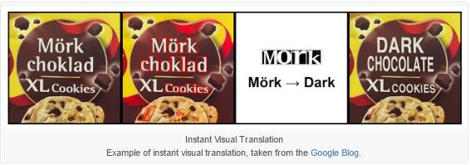
Applications of Deep Learning - Machine Translation
This is a task where you are given words in some language and you have to translate the words to the
desired language say ‘English’.
This kind of translation is a classical example of image recognition.

Slide 42
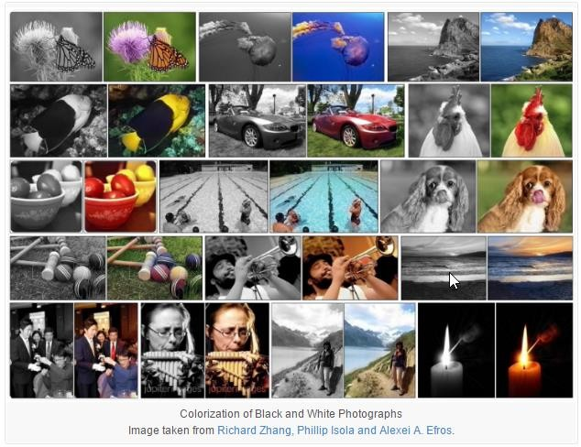
Applications of Deep Learning - Image Colorization
Automatic Colorization of Black and White Images:
Image colorization is the problem of adding colour to black and white photographs.

Slide 43

Open Source Tools
Now let’s understand the Open Source Tools is all about

Slide 44
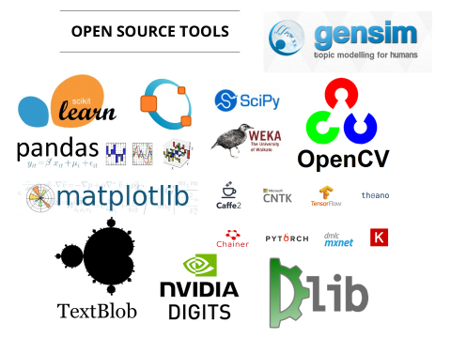
Open Source Tools

Slide 45

AI Applications
Now let’s understand the AI application is all about

Slide 46
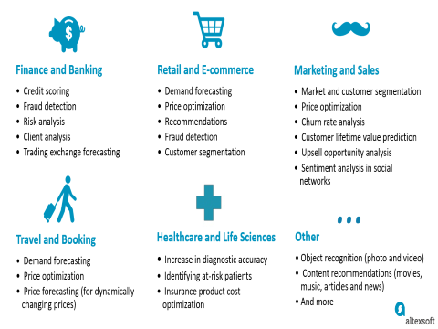
AI Applications

Slide 47
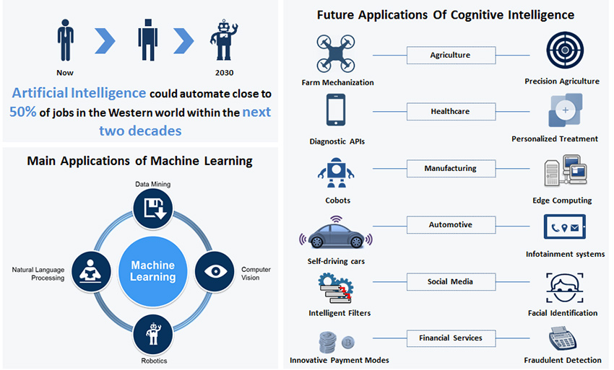

Slide 48
Futuristic
Now let’s understand what Future is all about

Slide 49
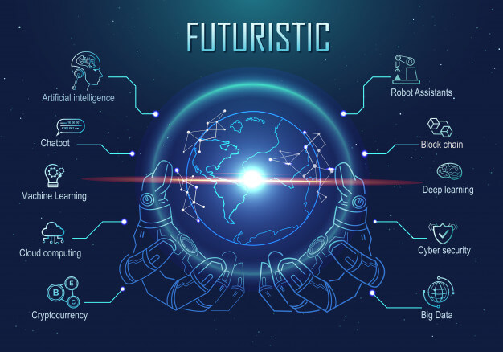
Futuristic Applications

Slide 50
Artificial Intelligence Course Content

Slide 51
Course Overview
Learning Objectives
Becoming an Artificial Intelligence Engineer puts you on the path to an exciting, evolving career that is predicted to grow sharply into 2020 and beyond. Artificial intelligence will impact all segments of daily life by 2025, with applications in a wide range of industries such as healthcare, transportation, insurance, transport and logistics and even customer service.
Current AI Market Trend
The New York Times reports a candidate shortage for certified AI Engineers, with fewer than 10,000 qualified people in the world to fill these jobs, which according to that, an average salary of $172,000 per year in the U.S. for engineers with the required skills.
Skills you will learn
Design and build your own intelligent agents and apply them to create practical machine learning models, logic constraint satisfaction problems, knowledge-base systems, probabilistic models.
Understand and master the concepts and principles of machine learning, including its mathematical and heuristic aspects.
Implement deep learning algorithms in keras backend with TensorFlow.
Understand neural networks, empowering you to analyse and utilize data in a better way.
Master advanced topics such as convolutional neural networks, recurrent neural networks, training deep networks and high-level interfaces
Learn about major applications of Artificial Intelligence across various use cases in various fields like customer service, financial services, healthcare etc.,
Ability to apply Artificial Intelligence techniques for problem-solving and explain the limitations of current A I techniques

Slide 52
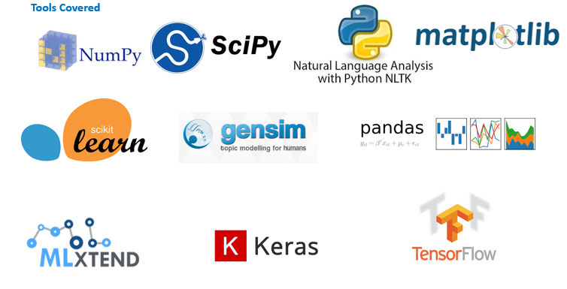
Tools Coverage

Slide 53
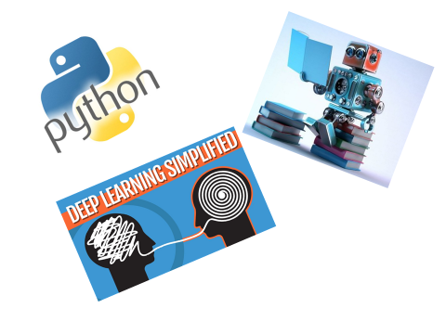
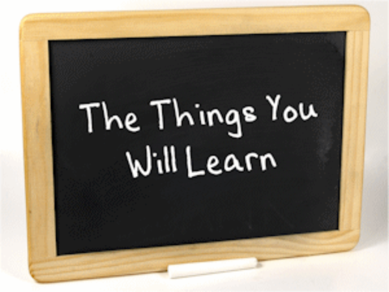
Course Coverage

Slide 54
Foundations of Artificial Intelligence
Foundations of AI
Python for AI (Significant Functions, Packages and Routines)
Statistics & Probability (Descriptive & Inferential Stats, Probability & Conditional Probability)
Visualization principles and techniques
Linear algebra
Calculus

Slide 55
Python Programming
Now let’s understand what Python Language is all about

Slide 56







Python Programming
Objective 1
To make you write python
scripts, unit test code
01
Objective 2
To make you analyze and
download data programmatically
02
03
Objective 3
Make you learn techniques to
deal with different types of data
– Ordinal, Categorical, Encoding
04
Objective 4
Learn Data Visualization
using Numpy, Pandas,
Matplotlib

Slide 57
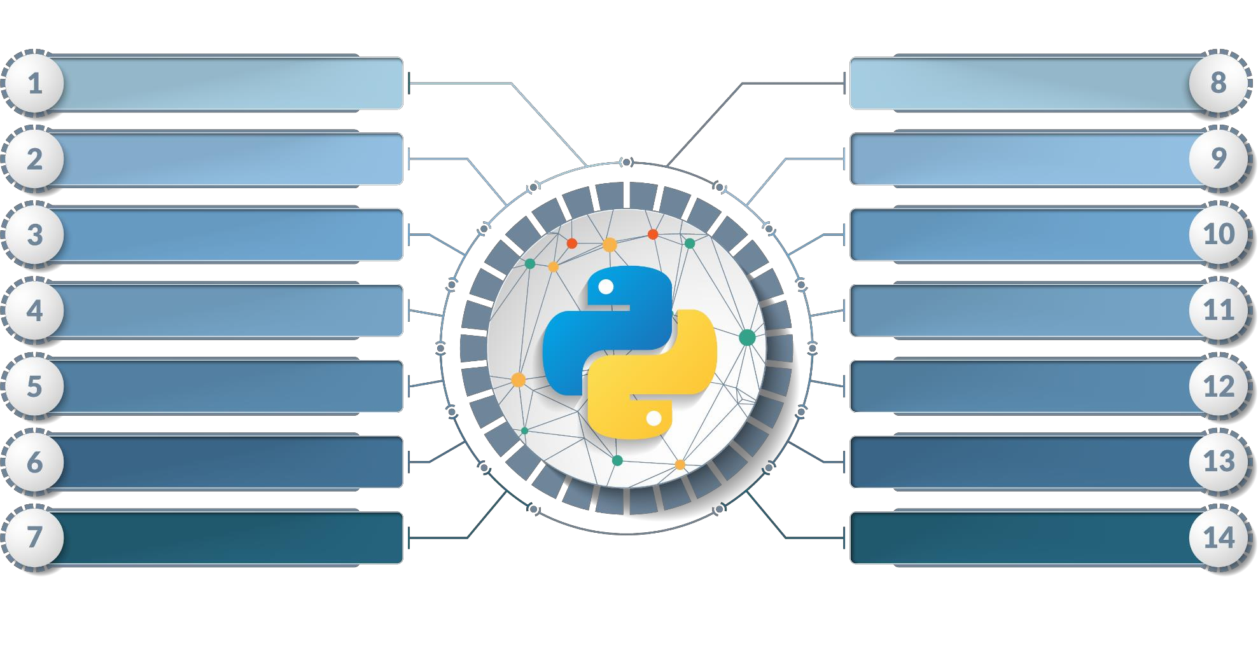
Python Programming Course Outline
Introduction to Python
Libraries – Functions, Modules
Basics of Python
object Oriented Programming
Program Flow Control
Exception Handling
String Manipulation
File Handling
List Manipulation
Database
Tuple Manipulation
Networking & Multithreading
Dictionaries Manipulation
Numpy, Pandas, Matplotlib, SciPy

Slide 58
Probability & Statistics
Now let’s understand what Probability & Statistics is all about

Slide 59

Probability & Statistics Essentials
Objective 01
Make you analyze different types of data
Help you understand sampling techniques and Probability concepts
Objective 02
Objective 03
Explain you the basis of Inferential
Statistics
Make you understand Regression and
Clustering concepts
Objective 04

Slide 60
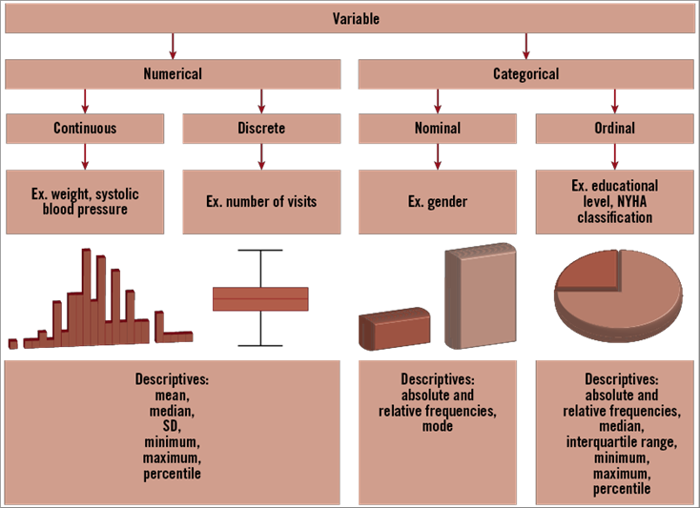
Probability & Statistics Course Outline

Slide 61
Probability & Statistics Course Outline
Foundations of Statistics
Statistical Jargons - Understanding the properties of an attribute - Central tendencies (Mean, Median, Mode) - Measures of spread (Range, Variance, Standard Deviation) - Z score
Foundations of Probability
Exclusive Event – Independent Event - Introduction to random variables – Joint probability – Marginal probability – Union probability – Conditional probability - probability theory, conditional probability, and to a most powerful algorithm in probability theory - Bayes Theorem – Probability tree – Confusion Matrix Discrete probability distributions - Bernoulli, Binomial – Geometric - Poisson and properties of each. Continuous probability distributions - Exponential - Special emphasis on Normal distribution - t- distribution - Central Limit Theorem - Sampling distributions - Confidence Intervals - Hypothesis Testing Statistical hypothesis - chi-square test - t-test - z-test - F-test – ANOVA

Slide 62
Machine Learning
Now let’s understand what Machine Learning is all about

Slide 63

Machine Learning using Python
Objective 1
Data Wrangling, Scikit-Learn, Linear
Regression, Overfitting, Underfitting,
Logisitic Regression
Objective 2
Decision Tree, Random Forest,
Confusion Matrix, PCA, LDA, Scaling, Naive Bayes, SVM
01
02
03
Objective 3
Recommendation Engines,
Market Basket Analysis, Appriori
Algorithm, Q Learning, MDP
04
Objective 4
ARIMA, Stationarity, ACF,
PACF, Cross Validation,
Boosting

Slide 64
Machine Learning Course Outline
Introduction to Data Operation
Basic Operations
Moving Data Around
Computing on Data
Plotting Data
Control Statements: for, while, if statement
Vectorization
Types of ML algorithm- an overview
Supervised learning
Unsupervised Learning
Reinforcement Learning
Linear Algebra
Matrices and Vectors
Addition and Scalar Multiplication
Matrix Vector Multiplication
Matrix Multiplication
Matrix Multiplication Properties
Inverse and Transpose
Practice Quiz: Linear Algebra
Linear Regression
Model Representation
Cost Function
Gradient Descent
Gradient Descent for Linear Regression
Features and Polynomial Regression
Normal Equation
Normal Equation Non-invertibility
Logistic Regression
Classification
Hypothesis Representation
Decision Boundary
Simplified Cost Function and Gradient Descent
Advanced Optimization
Multiclass Classification: One-vs-all
Regularization
The Problem of Overfitting
Regularized Linear Regression
Regularized Logistic Regression

Slide 65
Machine Learning Course Outline..
Machine Learning System Design
Prioritizing What to Work On
Inverse and Transpose
Error Metrics for Skewed Classes
Trading Off Precision and Recall
Data for Machine Learning
Supervised Learning
Regression (Linear, Multiple, Logistic)
Classification (k-NN, naïve Bayes, SVM) techniques
Decision Trees
Unsupervised Learning
Clustering (k-means, hierarchical, high-dimensional)
Expectation Maximization
Optimization Objective
Random Initialization
Choosing the Number of Clusters
Ensemble Method
Boosting and Bagging
Random Forests
Associative Learning
Aprior
Eclat
Large Scale Machine Learning
Learning with large datasets
Stochastic Gradient Descent
Mini-Batch Gradient Descent
Stochastic Gradient Descent Convergence
Map Reduce and Data Parallelism

Slide 66
Deep Learning
Now let’s understand what Deep Learning is all about

Slide 67

Deep Learning with TensorFlow
01
Objective 01
Explain and Train Neural Networks
02
Objective 02
Implement ANN, CNN and RNN
03
Objective 03
Discuss Backpropagation
04
Objective 04
Create LSTMs and Autoencoder Neural Network
architectures.

Slide 68
Deep Learning Course Outline
Deep Learning
Neural Network Basics
Deep Neural Networks
Recurrent Neural Networks (RNN) (LSTM, GRU, DCN, DMN, Bi-DAF)
Deep Learning applied to Images using CNN
Tensor Flow for Neural Networks & Deep Learning
Natural Language Processing
Statistical NLP and text similarity
Syntax and Parsing techniques
Text Summarization Techniques
Semantics and Generation
Topic Modelling (LDA, TF-IDF)
Computer Vision
Convolutional Neural Networks
Keras library for deep learning in Python
Pre-processing Image Data
Object & face recognition using techniques above
Neural Network (NN) introduction
Neurons and the Brain
Non-linear Hypothesis
perceptron
Multilayer perceptron
Training a neural network
Backpropagation primer
Gradients & optimization
Deep Learning for images
CNN architecture
Overview of modern CNN architectures
Pre-trained CNNs
Alexnet / Googlenet
OpenCV + NN

Slide 69
Deep Learning Course Outline..
Deep Learning for Text
RNN
LSTM
GRU
Pre-processing Techniques for Deep Learning
Tools For DL
Practical Applications

Slide 70


Copyright © 2017, edureka and/or its affiliates. All rights reserved.

Slide 71
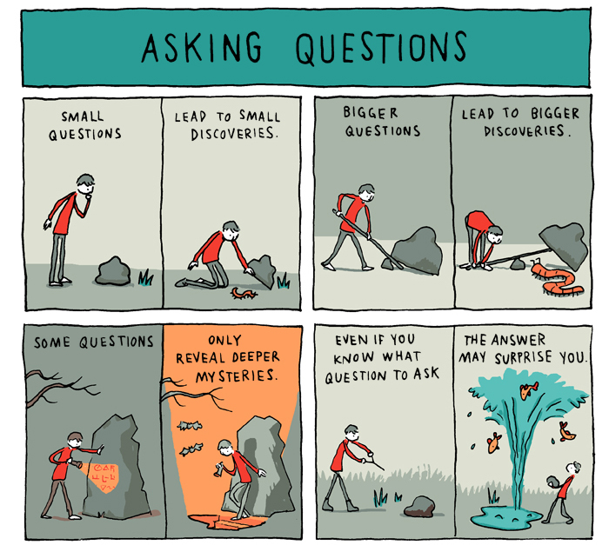

Slide 72
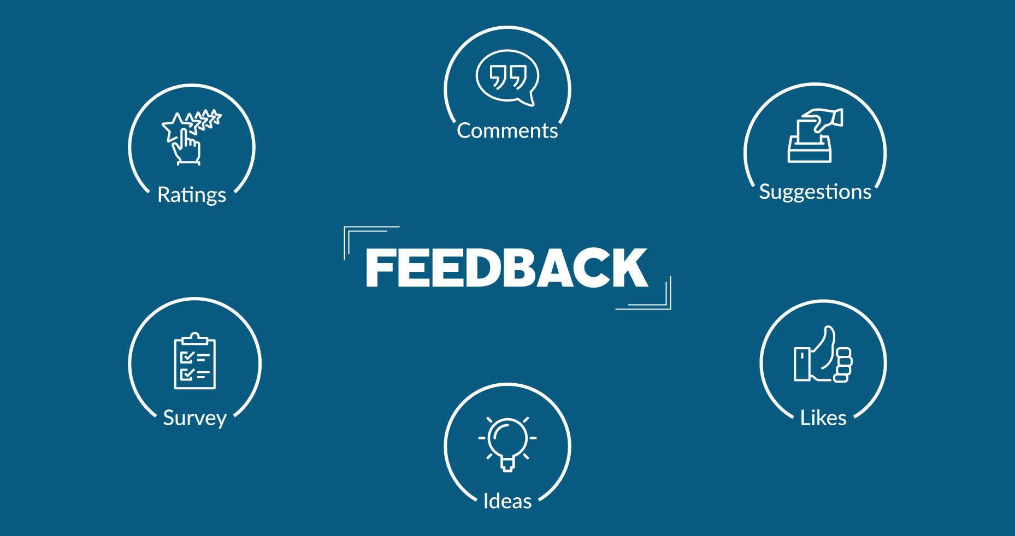
Copyright © 2017, edureka and/or its affiliates. All rights reserved.

Slide 73

